Slide 1
Getting Started with RAML (Session II)
Using API - Workbench
Alain Lompo
IT Consultant and Developer
RAML MVP

Slide 2
Program
What is RAML?
Why use RAML?
The API Workbench
How to install it
Using API workbench to build raml API
Starting with the Basics
Building your first RAML Api
How to add resources and methods
Adding more details to methods: bodies and responses

Slide 3
Program (II)
Handling sub – resources
Adding examples
Adding types
Handling resource types
Refactoring and extracting resource types
Adding resource type parameters
Handling method parameters
Traits
How to reuse traits, resource type and libraries

Slide 4
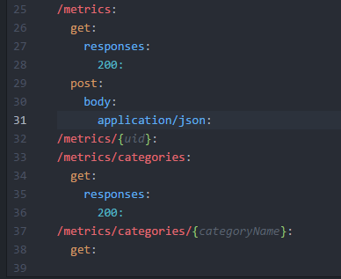
Adding response to get and body to post (we stopped here last time)

Slide 5
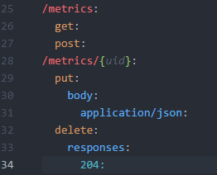
Adding a sub-resource
We can use the patter /collection/{id} to build to define additional modification and deletion action, which along with the read and create actions will form a complete CRUD

Slide 6
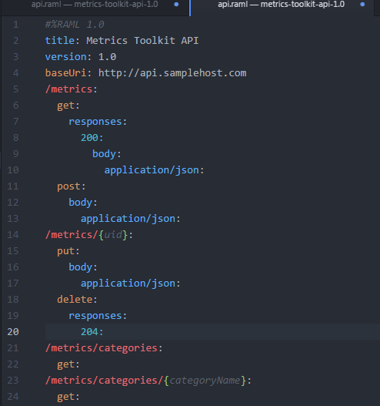
What does it look like, so far? ….

Slide 7
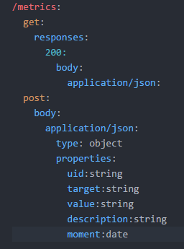
Specifying the structure of a data
We can specify precisely what our input or ouput data looks like. For example with the post body
We can also provide an example that illustrate an instance of the data as well as will be usefull for mocking the service

Slide 8
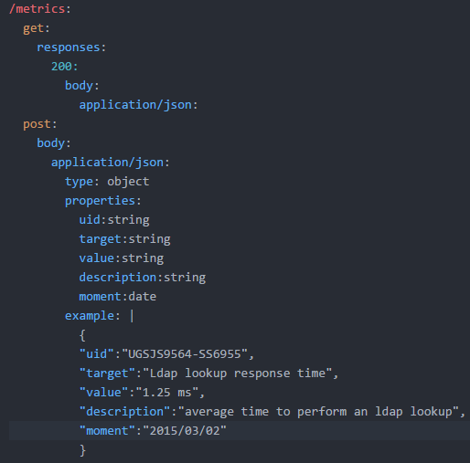
Adding a data example

Slide 9
Defining types for the purpose of reuse
The put method should accept the same properties in its body and the get methods should return an array of such objects (so with the same properties)
That’s a case were using a reuse pattern will make our code better
We define a new type called Metric at the root of our API tree

Slide 10
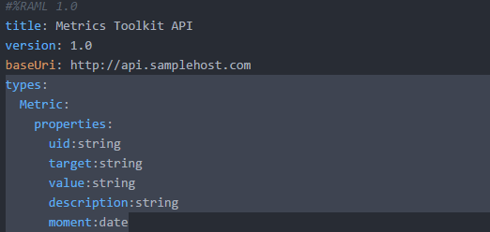
New « Metric » type

Slide 11
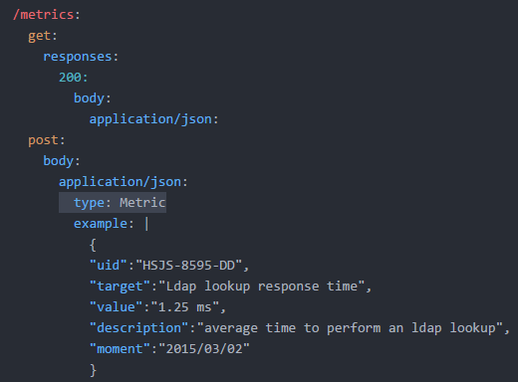
… and the use in the post method

Slide 12
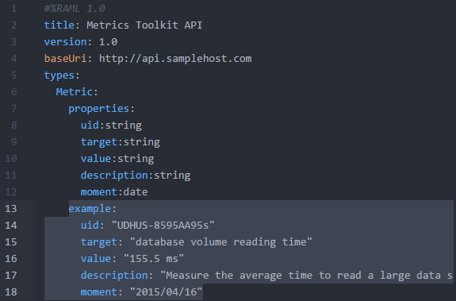
We can give example in type definitions

Slide 13
Applying the newly defined type to other action verbs
We can use the newly defined type with the put method
And we can make the get method returns a collection of elements of the new type
To indicate the collection in RAML we use the bracets [] (makes you think of an array in such languages as Java, C#, C++, …)

Slide 14
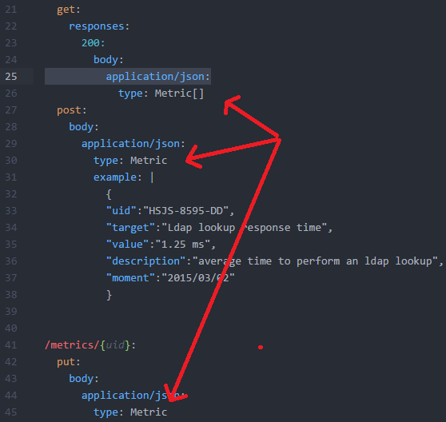
…

Slide 15

Lab time !!!
Now let’s practice what we’ve learned
Let’s build an API and use everything we have seen so far
I am interesting in knowing which theaters are displaying a particular movie… I am also interested in knowing what other movies they play, on a dayly, weekly and monthly basis.
I would also like to extend the experience to the other towns, to the whole country and to the world

Slide 16

Any question?

